Slide 1
Automatic Traffic Control
System Using Fuzzy Logic
MD.RAKIBUL HASAN RAKIB
SUB ID : UG02-59-22-002
MD. MUSTAFUZUR RAHMAN
SUB ID: UG02-59-22-019
ARBI AKTHER
SUB ID: UG02-56-21-010

Slide 2
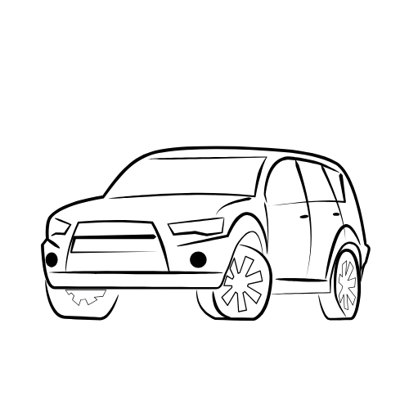
01
Introduction
02
Problem Description
03
Fuzzy Logic & FIS
CONTENTS
04
Inputs and Output
05
Fuzzy Rules
06
MATLAB Results
07
Conclusion

Slide 3
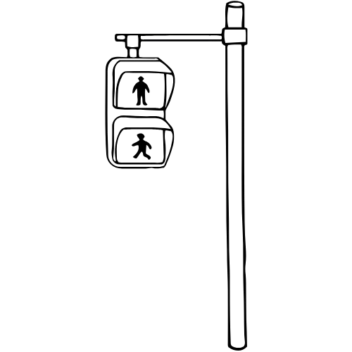
01
Introduction
Traffic jams are common in cities.
Fixed-time signals cannot handle changing traffic.
Fuzzy logic can make signals adaptive.
This reduces waiting time.

Slide 4
02
Problem Description
Fixed signals waste time: empty roads get green, busy roads wait too long.
Inputs: Traffic Density & Flow Rate.
Output: Cycle Length.
Goal: Adjust signals automatically.

Slide 5
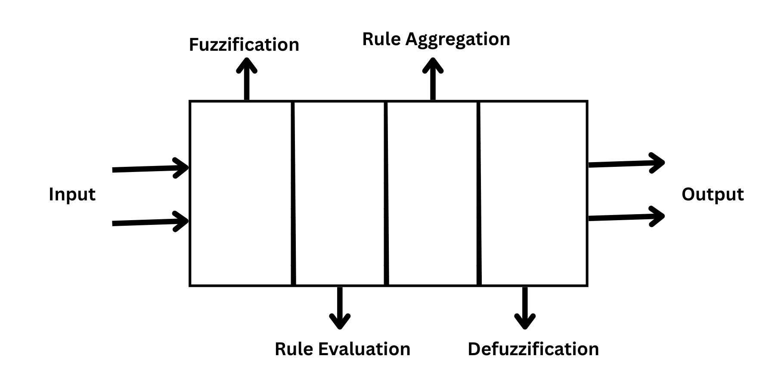
03
Fuzzy Logic & Fuzzy Inference System
Fuzzy logic is a way for computers to think more like humans.
Fuzzy Inference System has 4 steps:
1. Fuzzification (convert input to fuzzy sets)
2. Rule Evaluation (IF–THEN rules)
3. Rule Aggregation (apply rules)
4. Defuzzification (get crisp output).

Slide 6
04
Inputs and Output
Input 1: Traffic Density (cars/km)
Input 2: Traffic Flow Rate (cars/hour)
Output: Cycle Length (seconds)

Slide 7
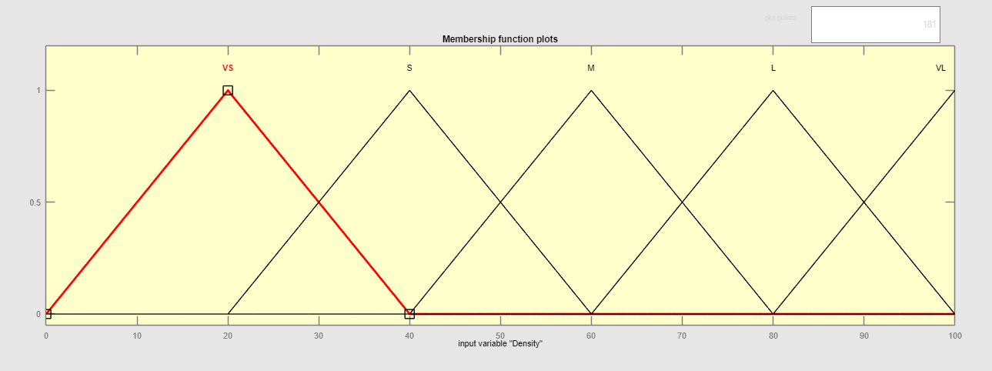
04
Inputs and Output
Traffic Density

Slide 8
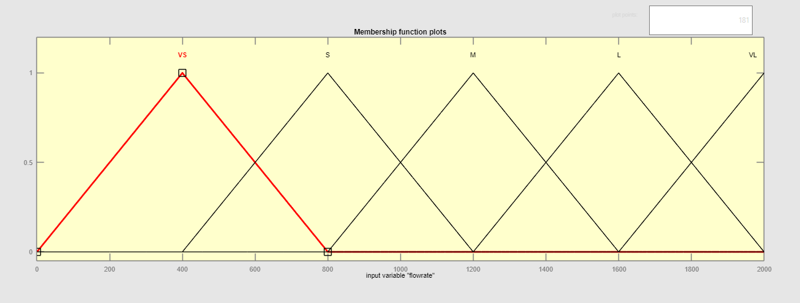
04
Inputs and Output
Traffic Flow Rate

Slide 9
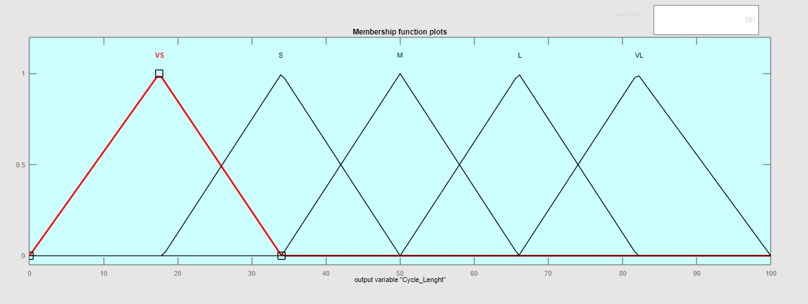
04
Inputs and Output
Cycle Length

Slide 10
05
Fuzzy Rules
25 rules cover all cases.
Example:
IF Density is Very Small AND Flow is Very Small→ Very Small Cycle
IF Density is Very Small AND Flow is Small→ Small Cycle
IF Density is Very Small AND Flow is Medium→ Small Cycle
IF Density is Very Low AND Flow is Medium→ Medium Cycle
IF Density is Very Large AND Flow is Large→ Large Cycle
.
.
.

Slide 11
06
MATLAB Results
MATLAB Fuzzy Toolbox used.
Membership functions designed.
Rule Viewer & Surface Viewer show output.

Slide 12
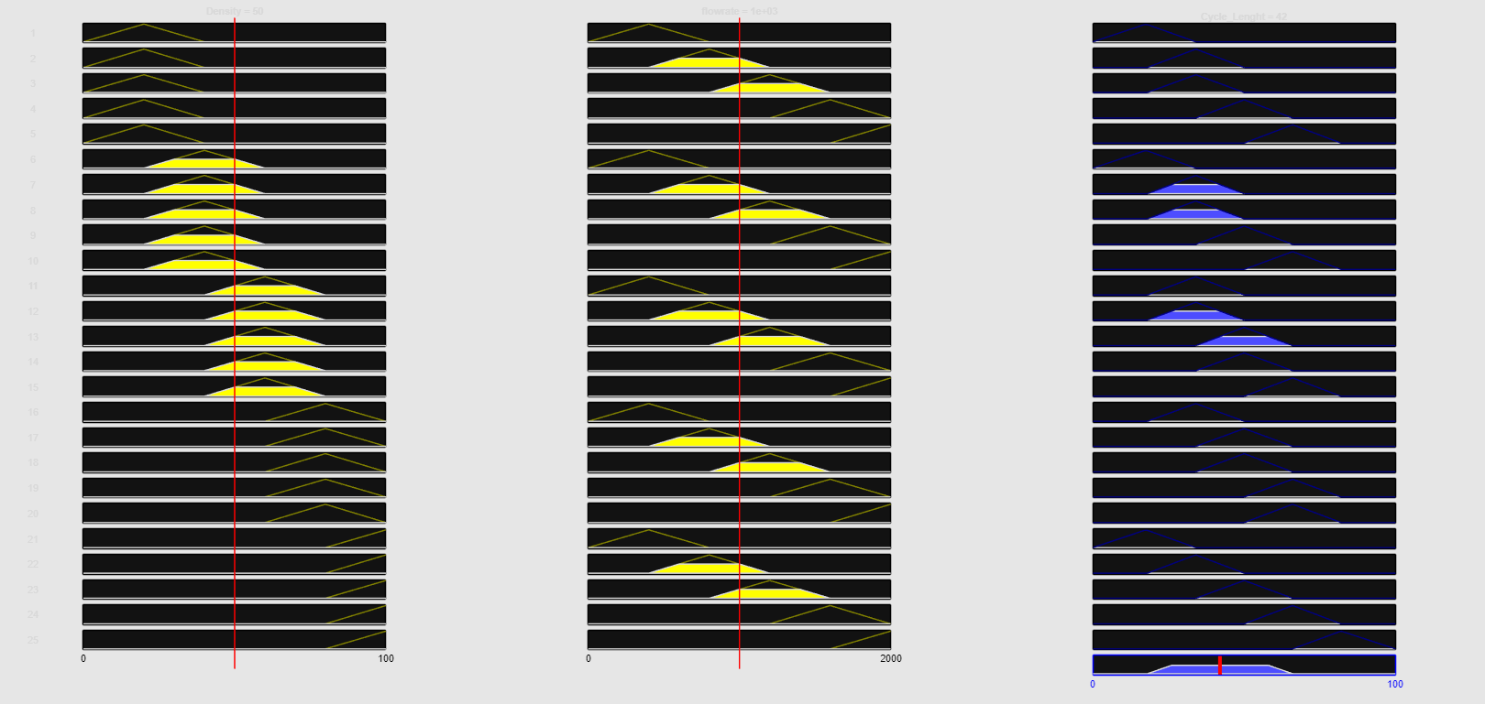
06
MATLAB Results
Rule Viewer

Slide 13
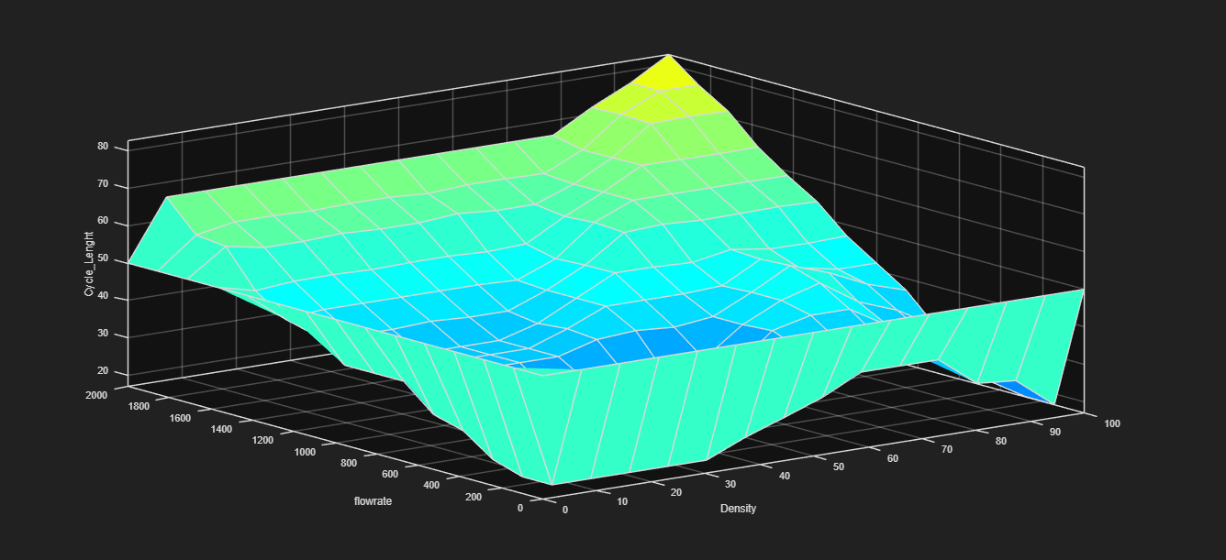
06
MATLAB Results
Surface Viewer

Slide 14
07
Conclusion
Fuzzy system adapts signals automatically.
Reduces waiting time & congestion.
Better than fixed-time system.

Slide 15
THANK YOU

